Slide 1

Credit Card Fraud
Ridwan Muhammad Syahrul
RMT-029

Slide 2
OUTLINE
01
Workflow
02
Data Searching
03
Data Understanding
04
EDA and Feature Engineering
05
Modelling
06
Conclusions

Slide 3
01
Workflow

Slide 4
Workflow
Data Searching
Data
Understanding
EDA and
Feature
Engineering
Modelling
Data Searching

Slide 5
02
Data Searching

Slide 6
Data Searching
Website used:
Kaggle datasets
Datasets found:
Loan Default Prediction Dataset
Credit Card Fraud Prediction (Used dataset)
Used car price predictions

Slide 7
03
Data Understanding

Slide 8
Data Understanding
Dataset has 555719 data with 22 attributes.
Attribute list:
Dataset has no missing value and duplicates.
No | Attribute Name | Description
1 | Trans_date_trans_time | Timestamp of the transaction (date and time)
2 | Cc_num | Unique customer identification number
3 | Merchant | The merchant involved in the transaction
4 | Category | Transaction type (e.g., personal, childcare)
5 | Amt | Transaction amount
6 | First | Cardholder's first name
7 | Last | Cardholder's last name
8 | Gender | Cardholder's gender
9 | Street | Cardholder's street address
10 | City | Cardholder's city of residence
11 | State | Cardholder's state of residence
No | Attribute Name | Description
12 | Zip | Cardholder's zip code
13 | Lat | Latitude of cardholder's location
14 | Long | Longitude of cardholder's location
15 | City_pop | Population of the cardholder's city
16 | Job | Cardholder's job title
17 | Dob | Cardholder's date of birth
18 | Trans_num | Unique transaction identifier
19 | Unix_time | Transaction timestamp (Unix format)
20 | Merch_lat | Merchant's location (latitude)
21 | Merch_long | Merchant's location (longitude)
22 | Is_fraud | Fraudulent transaction indicator (1 = fraud, 0 = legitimate)

Slide 9
04
EDA and
Feature Engineering

Slide 10
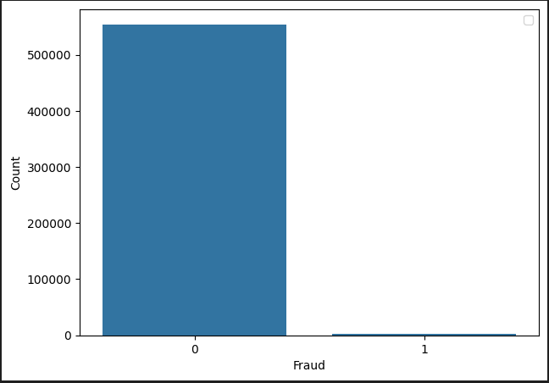
Exploratory Data Analysis (EDA)
Value count:
Legitimate (0): 553574
Fraud (1): 2145

Slide 11
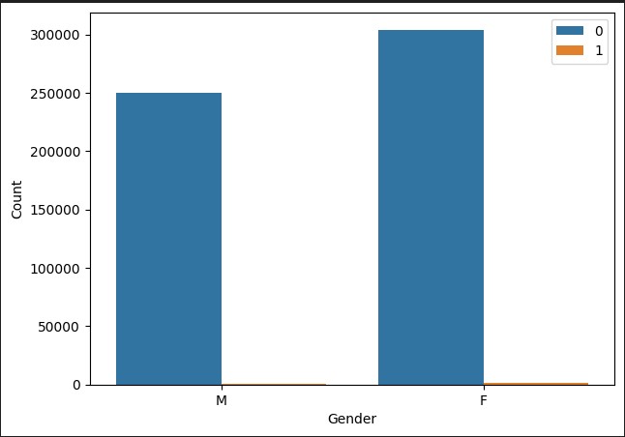
Exploratory Data Analysis (EDA)
Value count Male:
Legitimate: 250833
Fraud: 981
Value count Female:
Legitimate: 304886
Fraud: 1164

Slide 12
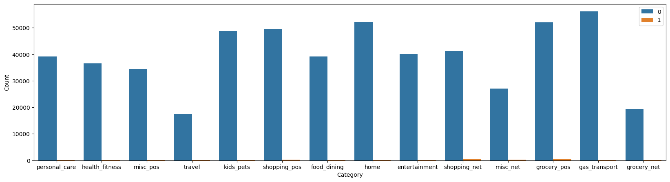
Exploratory Data Analysis (EDA)
No | Category | Fraud Count
1 | shopping_net | 506
2 | grocery_pos | 485
3 | misc_net | 267
4 | shopping_pos | 213
5 | gas_transport | 154
6 | misc_pos | 72
7 | personal_care | 70
No | Category | Fraud Count
8 | Home | 67
9 | Kids_pets | 65
10 | Entertainment | 59
11 | Food_dining | 54
12 | Health_fitness | 52
13 | Grocery_net | 41
14 | Travel | 40

Slide 13
Feature Engineering
Attribute that was used as a target in this data is ‘is_fraud’.
Some attributes was dropped:
'city', 'zip’, and 'street’ was dropped because their cardinality are too high. Those attribute can be represented by ‘state’.
'first' dan 'last’ was dropped because people’s name doesn’t affect credit card fraud prediction.
'cc_num', 'trans_num', 'trans_date', dan 'trans_time’ was dropped because it doesn’t have correlation with our target.
Attribute was splitted into numerical and categorical:
numerical = 'amt', 'city_pop', 'unix_time’
categorical= 'merchant', 'category', 'gender', 'state', 'job’
Data was splitted into 70-30% ratio for train and test set

Slide 14
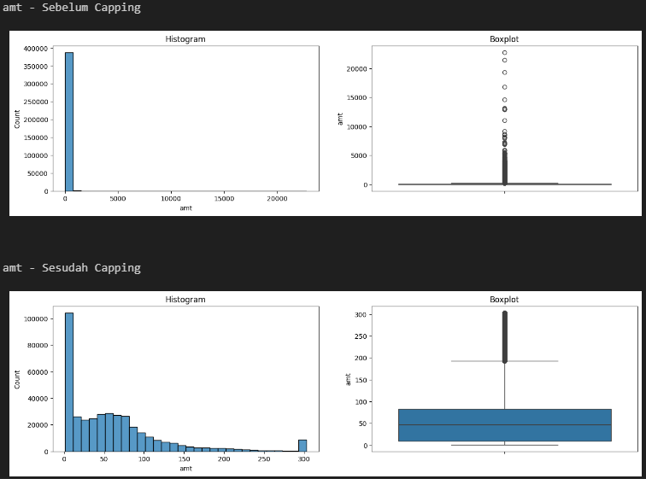
Feature Engineering
Handling Outlier ‘amt’:

Slide 15
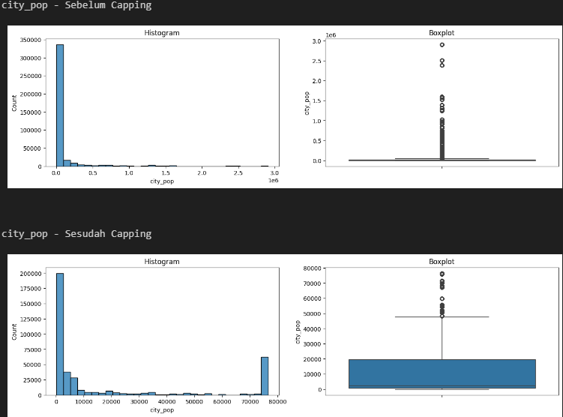
Feature Engineering
Handling Outlier ‘city_pop’:

Slide 16
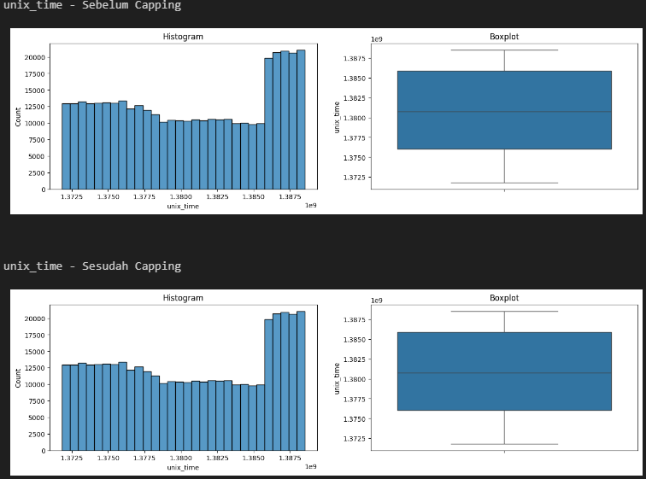
Feature Engineering
Handling Outlier ‘unix_time’:

Slide 17
Feature Engineering
No missing value handling
Scaling: RobustScaler
Encoding: OrdinalEncoder

Slide 18
05
Modelling

Slide 19
Modelling
Model Used:
SVM (rbf)
K-Nearest Neighbor
Decision Tree
Random Forest
Boosting (Gradient Boosting)
F1 Score:
No | Model Name | F1 Score - Train | F1-Score - Test
1 | SVM (rbf) | 0.9943 | 0.9940
2 | K-Nearest Neighbor | 0.9943 | 0.9940
3 | Decision Tree | 0.9969 | 0.9966
4 | Random Forest | 0.9973 | 0.9973
5 | Boosting (Gradient Boosting) | 0.9964 | 0.9959

Slide 20
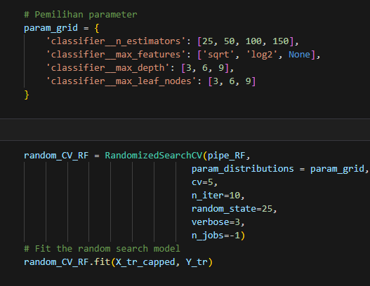
Modelling
Parameter for Random Forest Hyperparameter Tuning:
Best Parameter:
n_estimators: 100,
max_leaf_nodes: 6,
max_features: None,
max_depth: 6

Slide 21
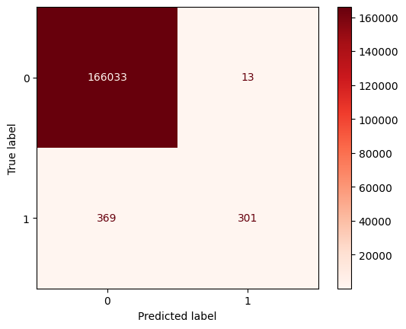

Modelling
RF Baseline Hyperparameter Tuning
No | Model Name | F1 Score – Train | F1-Score – Test
1 | RF Baseline | 0.9973 | 0.9973
2 | RF Hyperparameter Tuning | 0.9960 | 0.9958

Slide 22
06
Conclusions

Slide 23
Conclusions
From the visualization that we got, the difference between legitimate and fraud credit card count is significant, thus make the dataset imbalance.
From the chart regarding fraud data by gender, more fraudulent credit cards are owned by females. However, the number of female credit card owners is greater than the number of male credit card owners, thus the ratio of female and male credit card fraud owners is almost the same.
From the visualization results obtained regarding fraud data based on category, credit card fraud occurs more often in grocery_pos and shopping_net type transactions.
From the Model Evaluation results, it was found that the RF model can predict data more accurately than the SVM, KNN, DT and Gradient Boost models.
Model:
https://huggingface.co/spaces/RidwanMS/Prediksi_Credit_Card_Fraud

Slide 24
THANK YOU

